Slide 1

Web Scrapping For Customer Feedback

Slide 2
THE DATASET
From the first recent 40 pages analyzed, obtained from Airline Quality
Total Reviews Analyzed: 3,903
Verified Reviews: 2,068
Unverified Reviews: 310
Status Unknown: 1,525

Slide 3
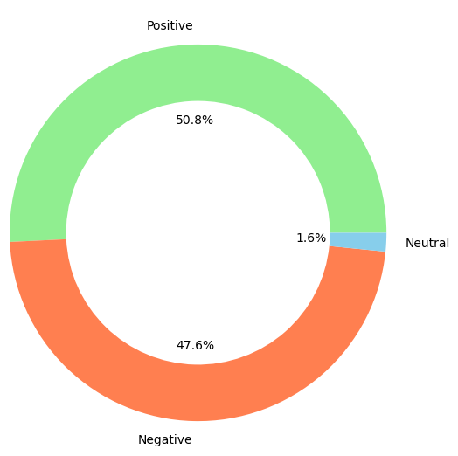
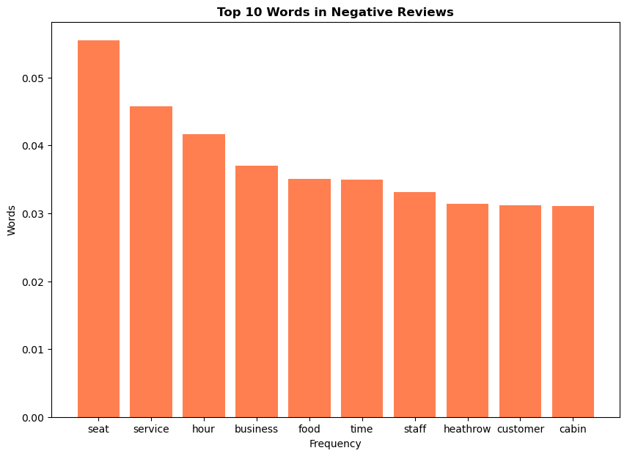
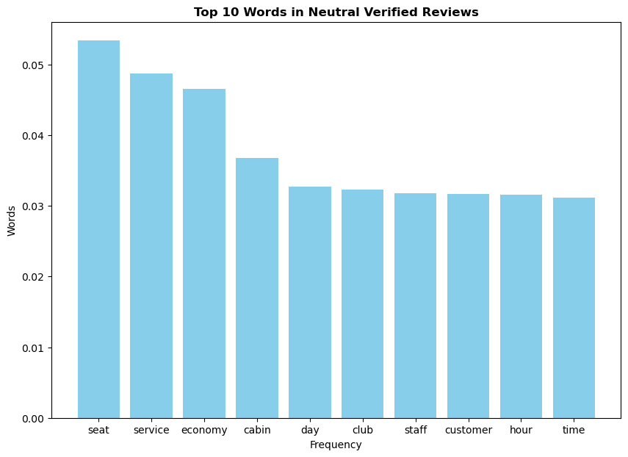
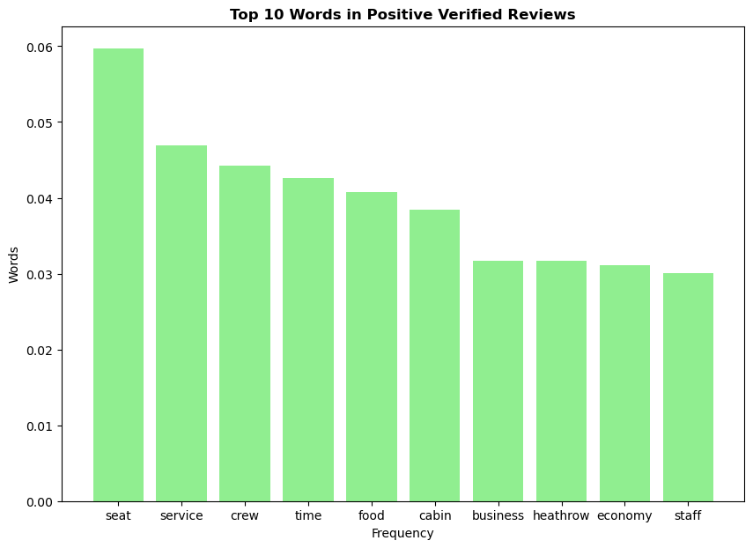
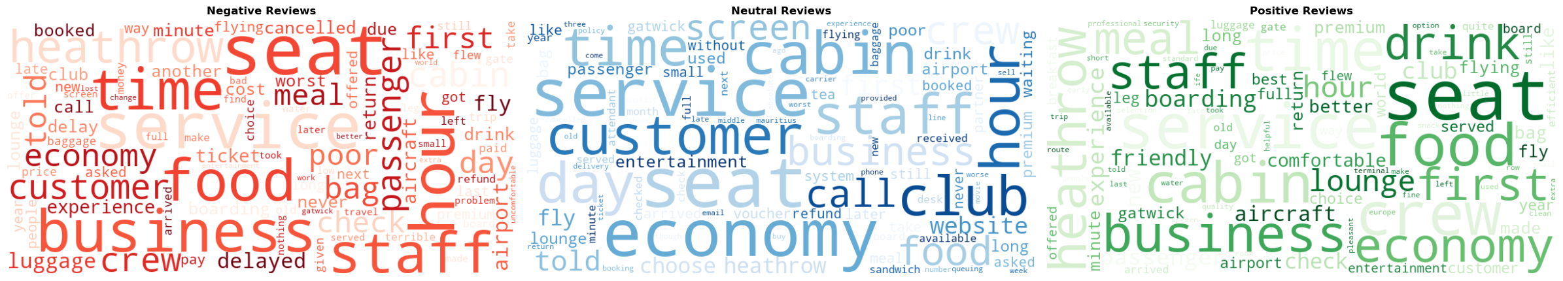
VERIFIED CUSTOMER REVIEWS

Slide 4
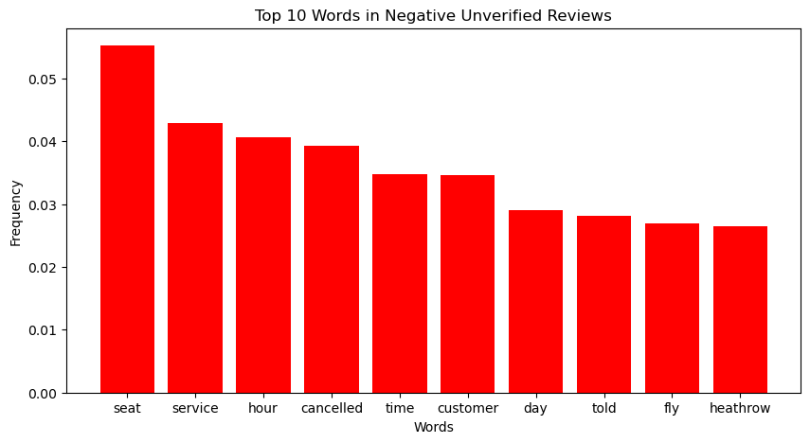
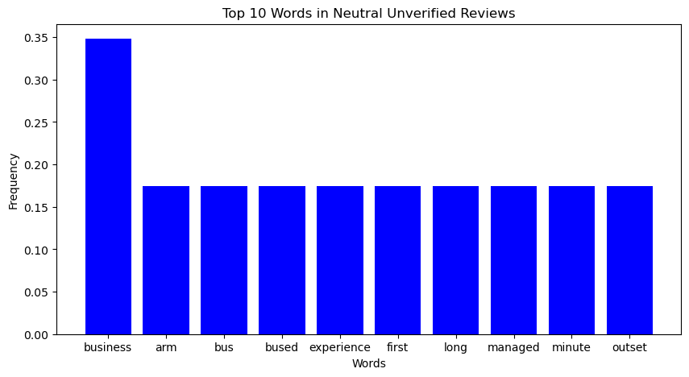
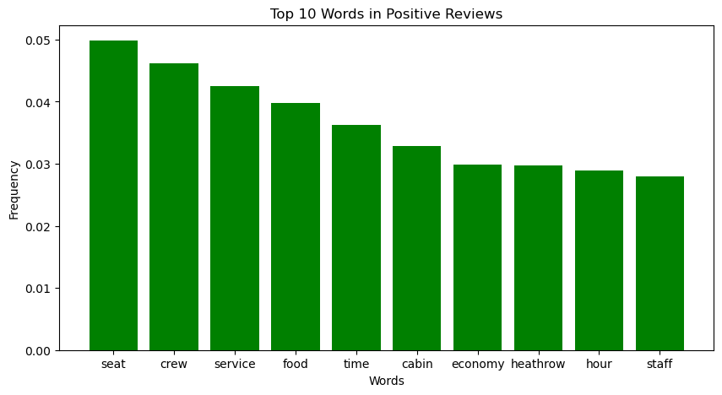
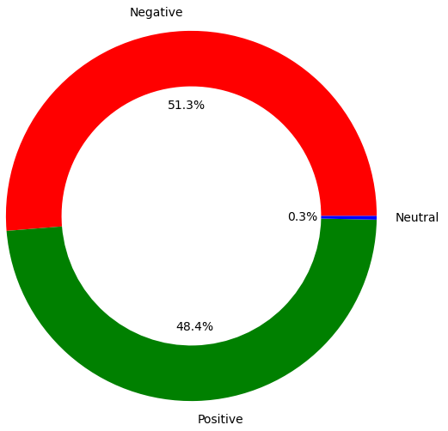
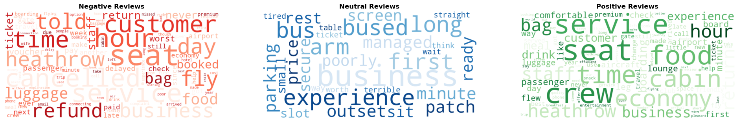
UNVERIFIED CUSTOMER REVIEWS

